Slide 1

Analyzing California Wildfire Severity Through Time
Golden Jaguar Warriors
Erik Arbelo-Nguyễn, Jake Boden, Kenneth Chang
University of California, Irvine Department of Continuing Education
Data Analytics & Visualization
Project 1

Slide 2

Dataset
https://www.kaggle.com/datasets/rtatman/188-million-us-wildfires
SQLite
Converted dataset to a .CSV file
Made the dataset for digestible by:
Only including California
Removing redundant columns

Slide 3
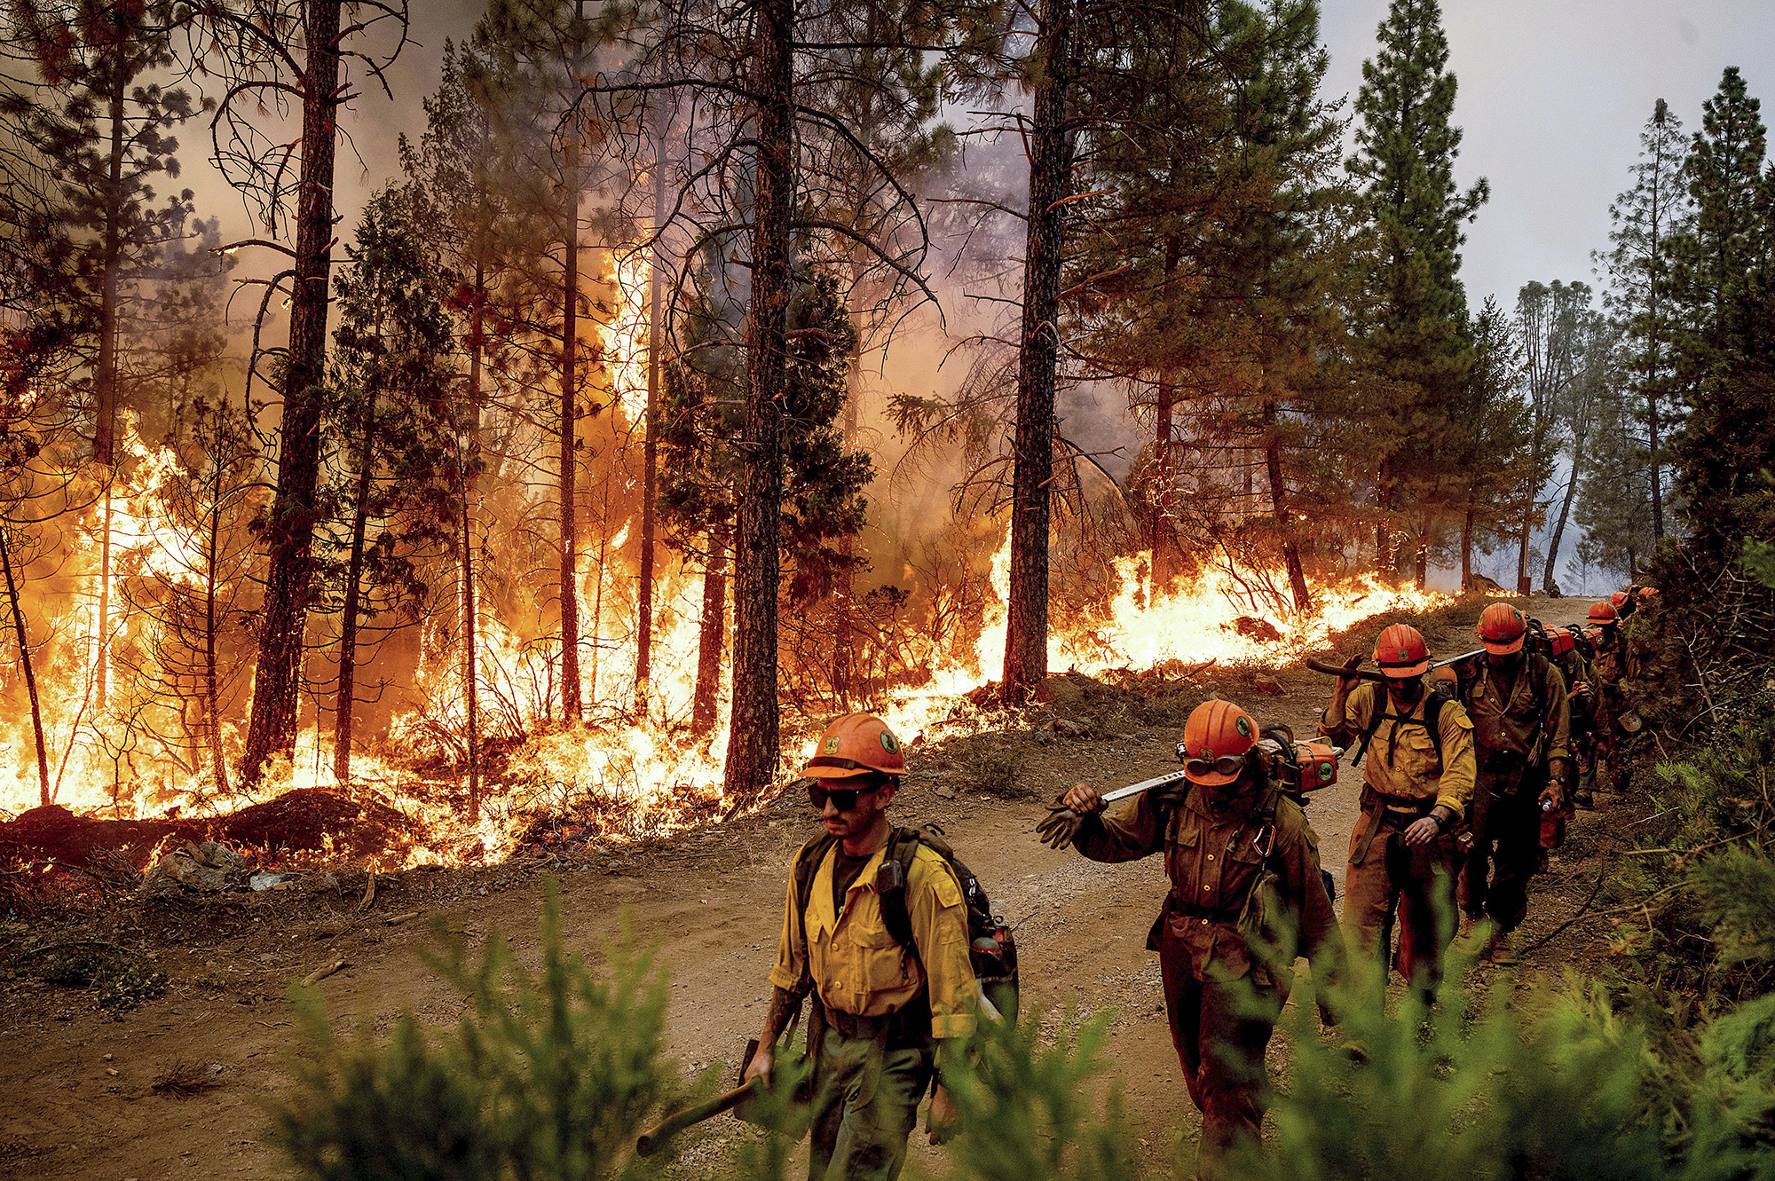
Project Thesis
The genesis of our project was to identify if California wildfires have become more severe over time.
In addition, we wanted to see if we could define the cause(s) that have exacerbated or potentially placated this circumstance.

Slide 4
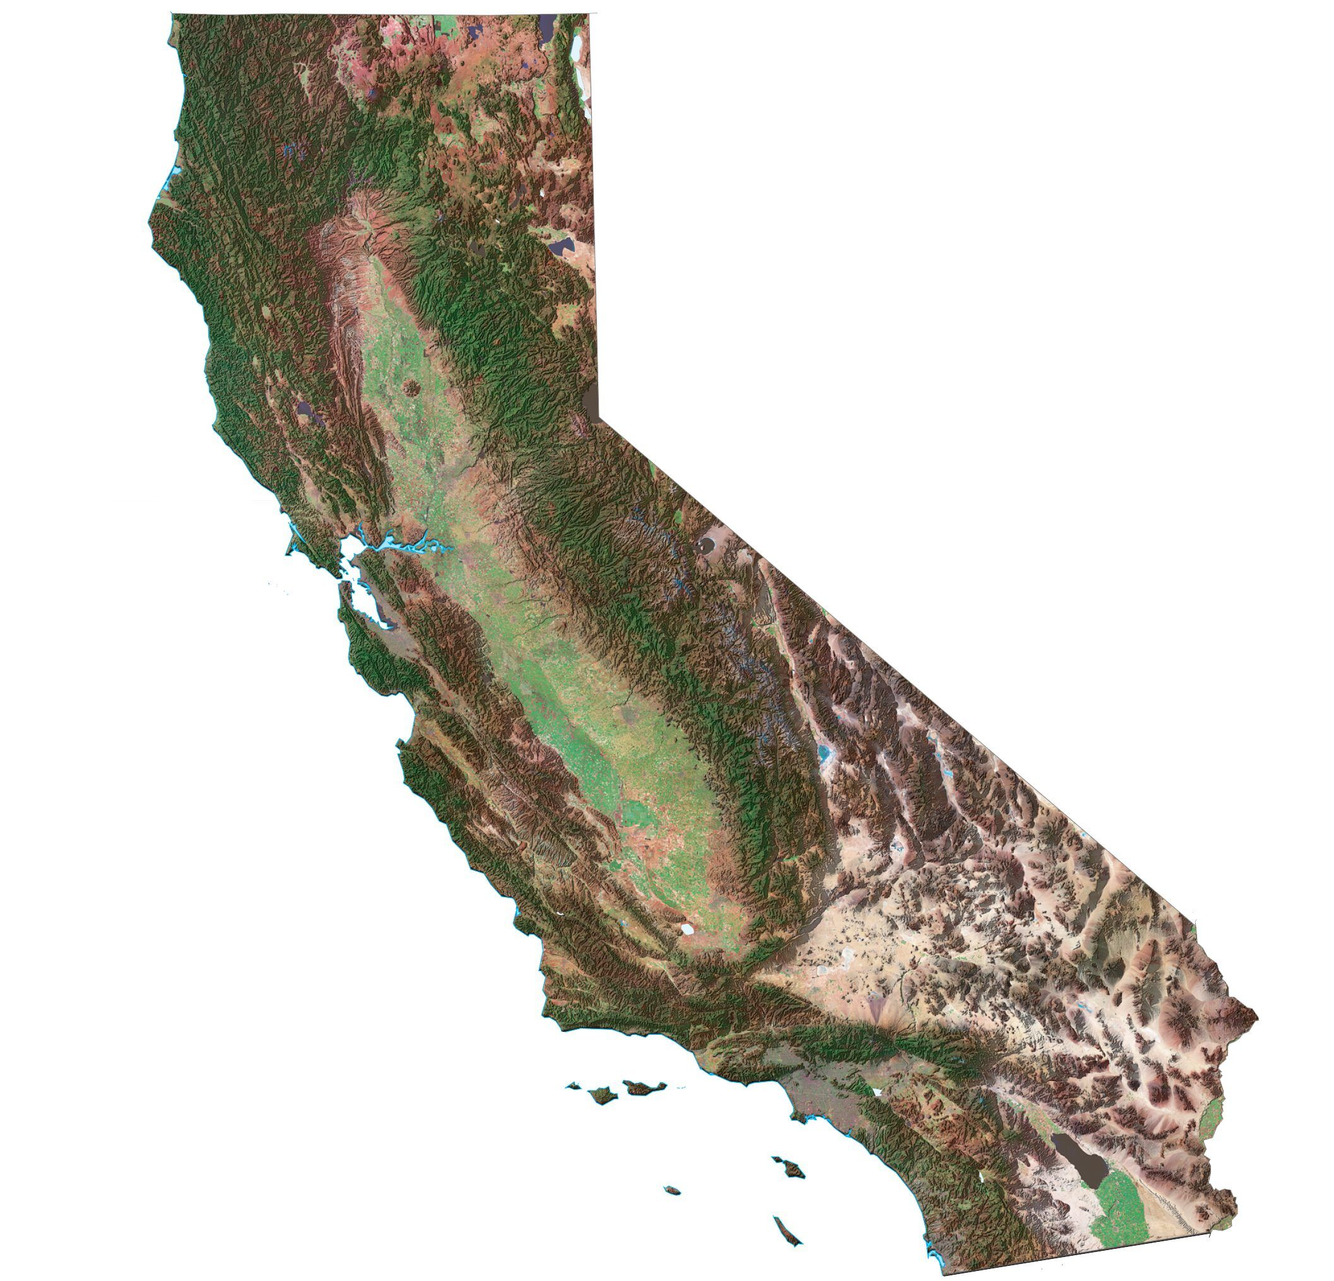
Defining the Analysis
First, we defined that we would measure acreage burned in our analysis.
We analyzed 2,000 wildfires across California from 2001 to 2020 comprising of each year's 100 largest wildfires.
Additional questions:
What is the cause of most wildfires: nature or man?
Are wildfires caused by mankind worse than those caused by nature?
Northern California vs. Southern California?

Slide 5
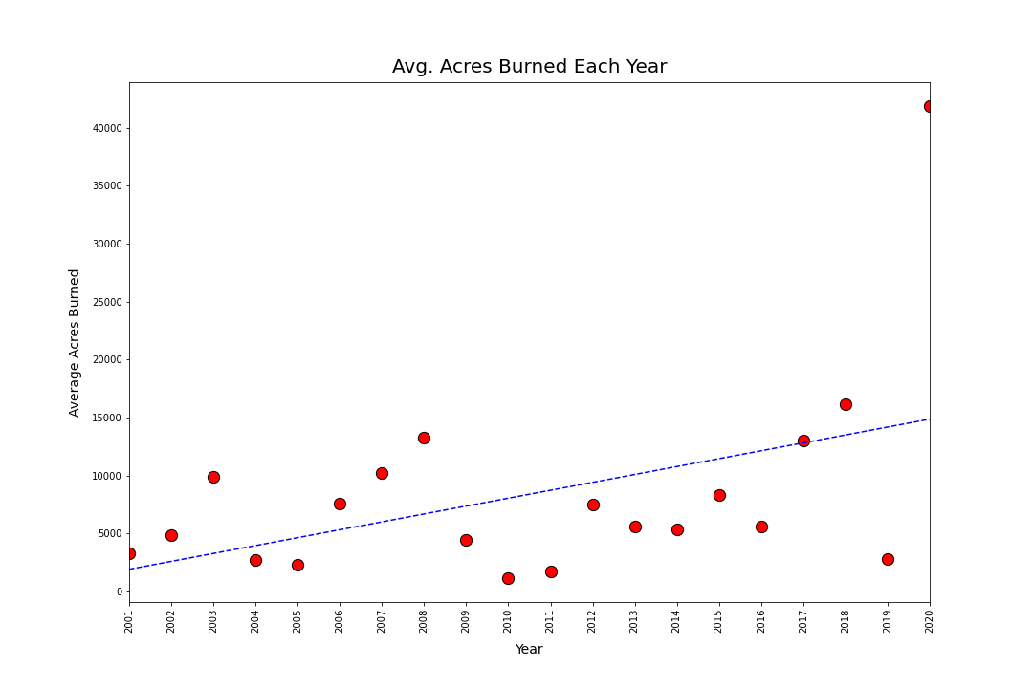
Beginning the Analysis
We were able to quickly conclude that: yes, California wildfires have become more severe over time.
Digging deeper, we additionally analyzed:
Average acres burned by:
Month
Latitude & Longitude
Human cause(s)
Further analysis of Northern vs. Southern California

Slide 6

Further Analysis & Visualizations

Slide 7
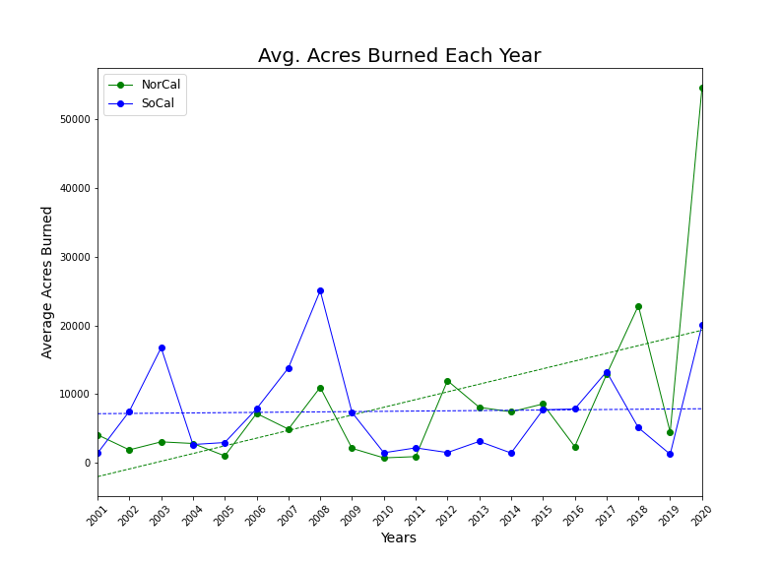
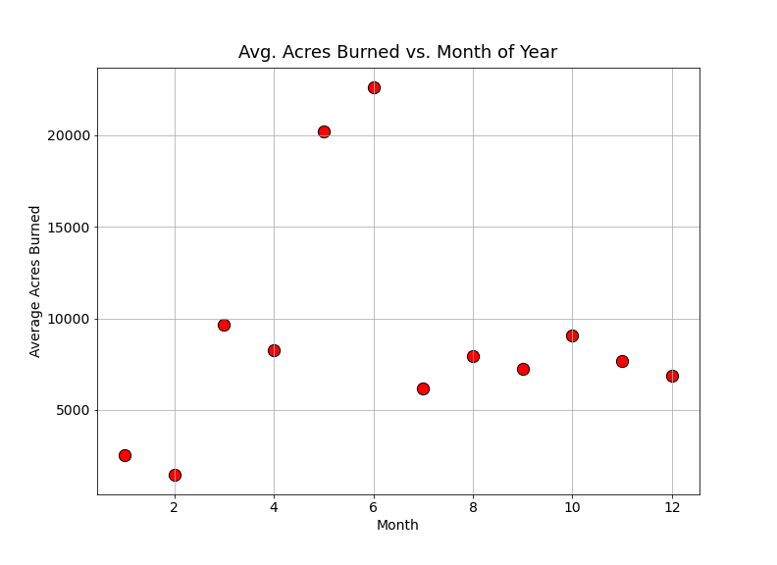
Average Acres Burned by Month & Year

Slide 8
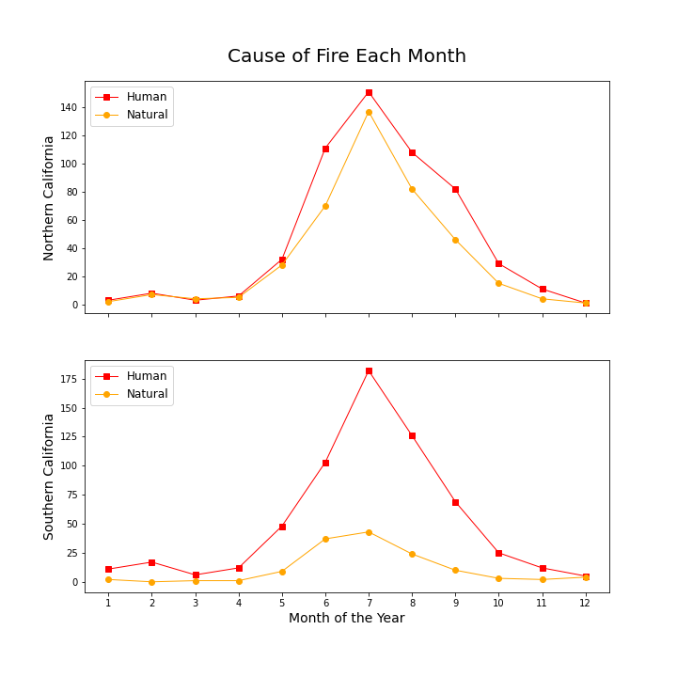
Fire Cause by Month

Slide 9
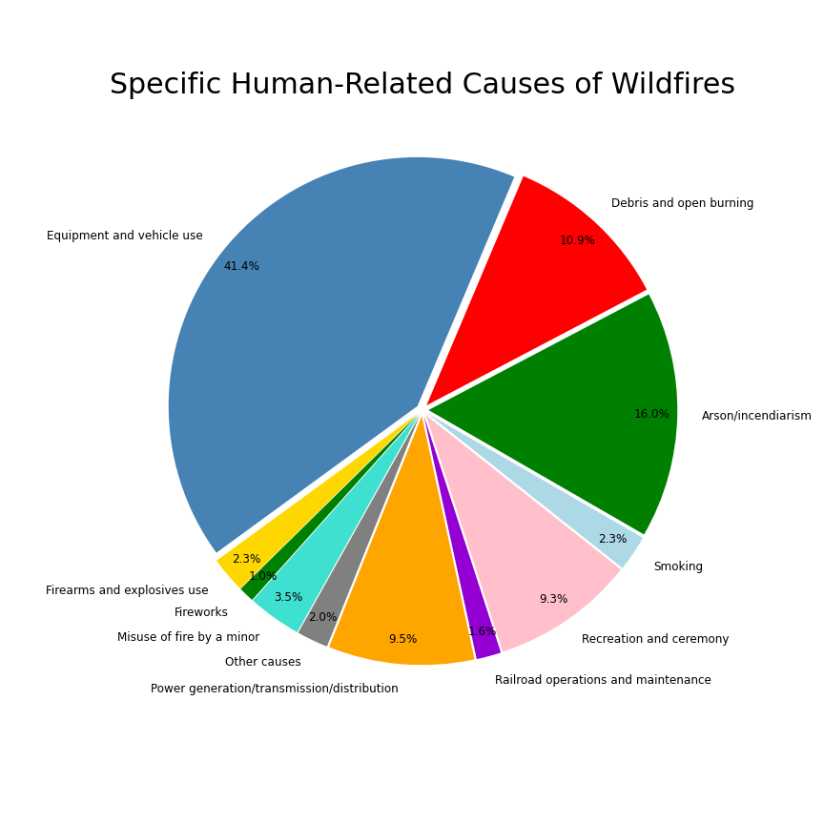
Exploring Fires Caused by Humans

Slide 10
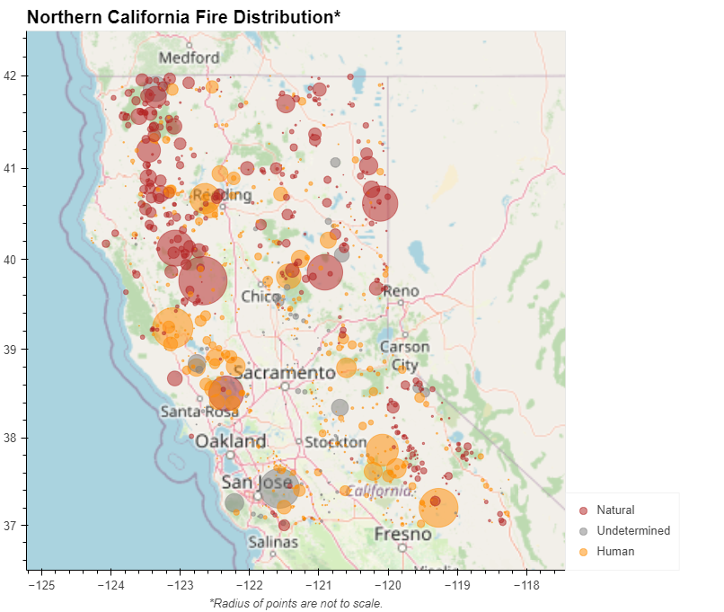
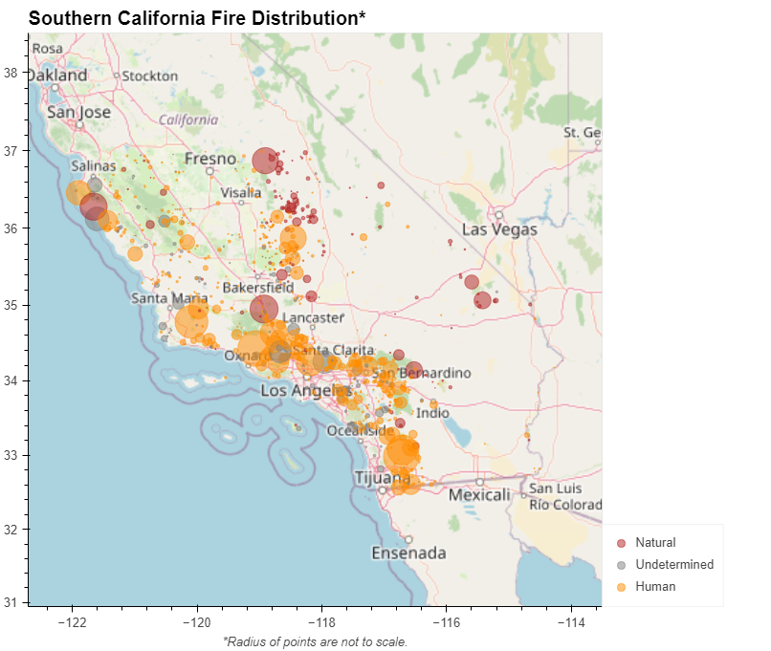
Northern California vs. Southern California

Slide 11
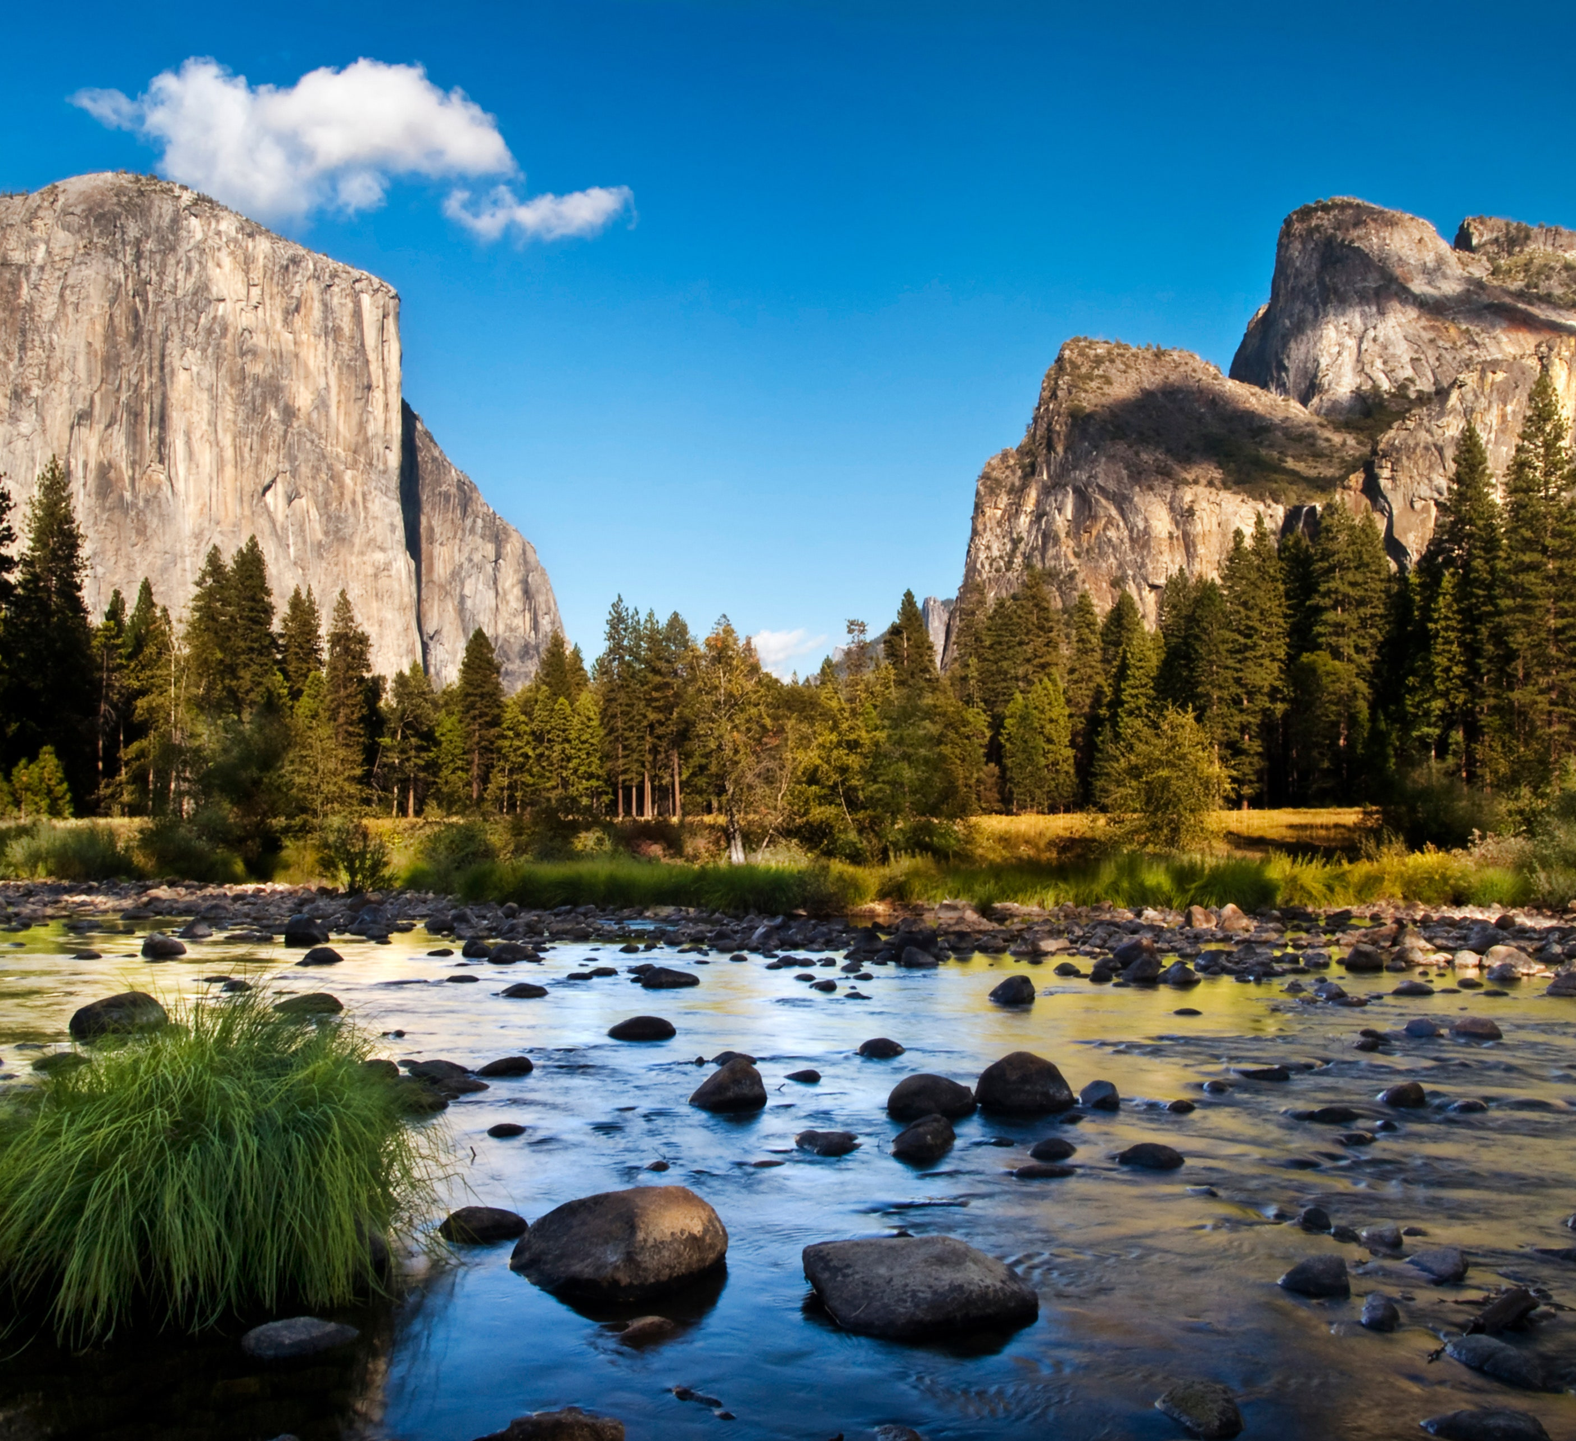
Conclusion
Analyzing wildfires from the past two decades has indeed shown that wildfires are worsening each year across California.
Humans are predominately the cause of wildfires, which is especially prevalent in Southern California.
Warmer months see the peak of wildfire severity which can be attributed to hotter, drier weather, and recreational human activities such as tourism, and camping.

